Slide 1
L. Yu, S. Wang, X. Li, C.-W. Fu, and P.-A. Heng, “Uncertainty-Aware Self-ensembling Model for Semi-supervised 3D Left Atrium Segmentation,” in MICCAI 2019, vol. 11765，pp. 605–613.
2020.4.2
胡敬玉

Slide 2
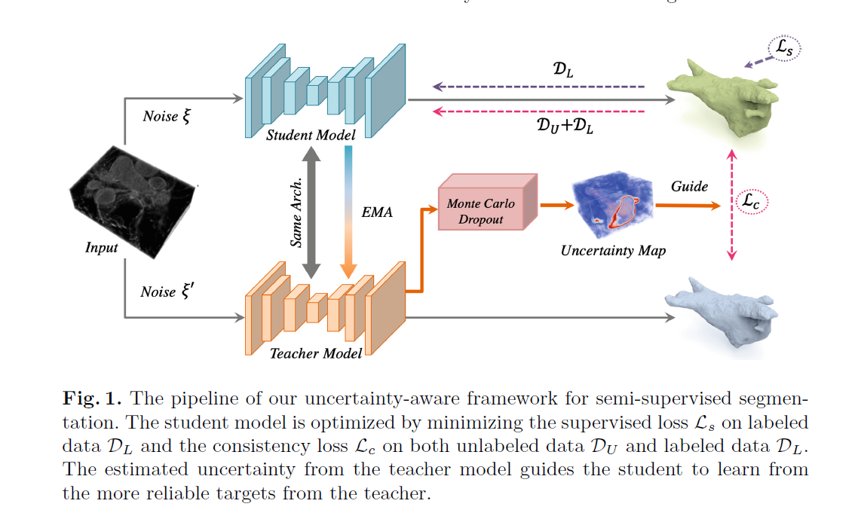

Slide 3
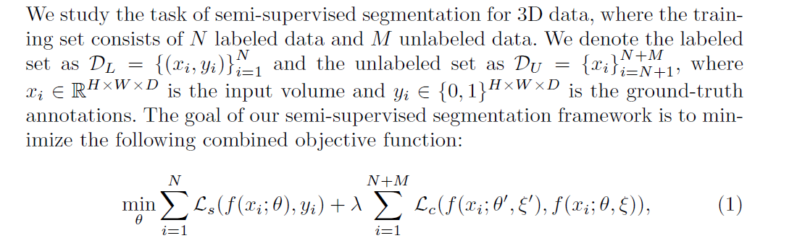
Loss Function

Slide 4
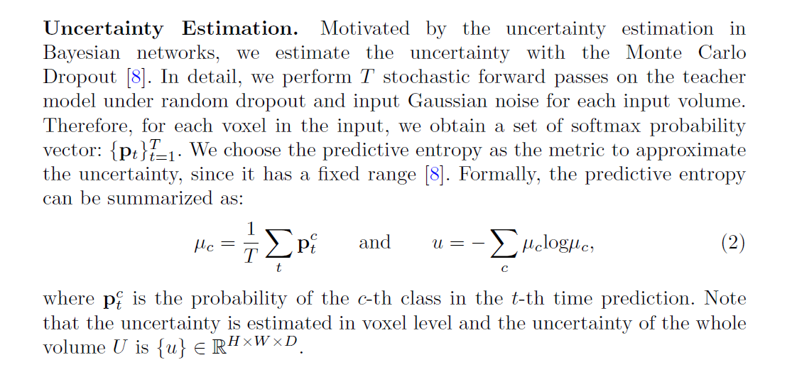
Uncertainty Estimation

Slide 5
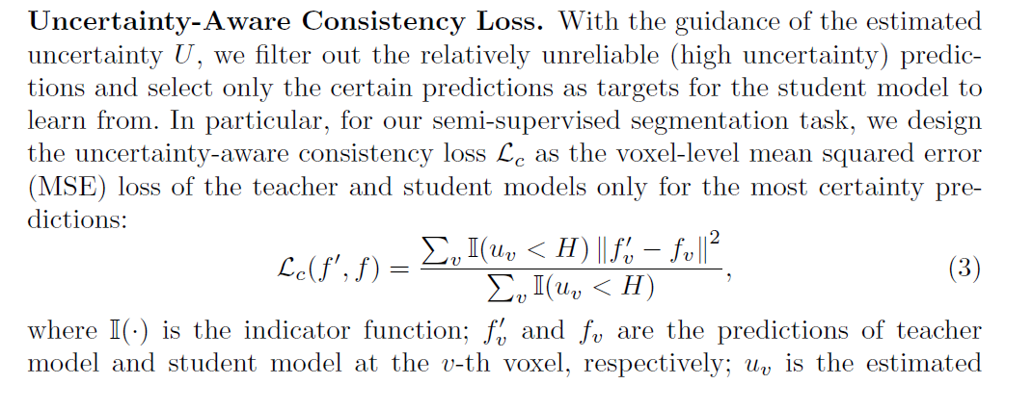
Uncertainty-Aware Consistency Loss

Slide 6
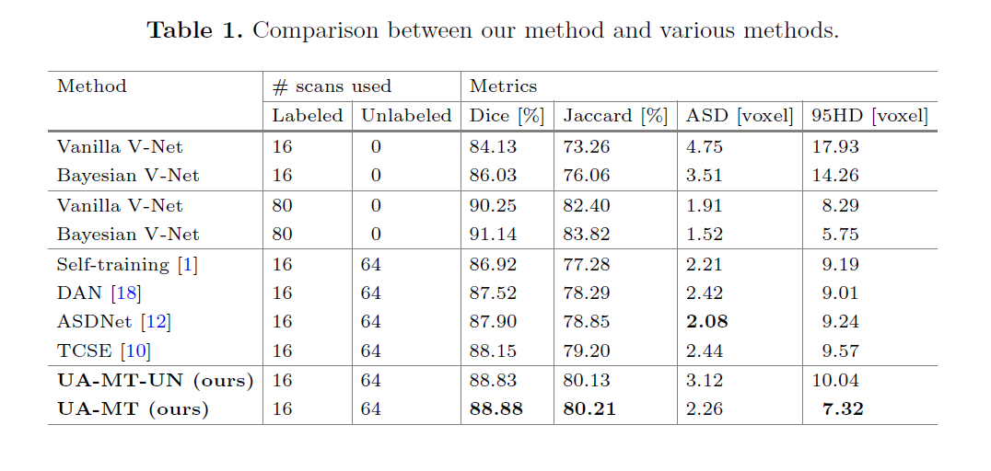
实验

Slide 7
Thank You!

